Slide 1
Bank Marketing Project
Loye Mansor

Slide 2
Decision Tree Classifier
Involved using a sampler to correct Imbalance – SMOTE + ENN
Minimizing the Cost Complexity Parameter
Minimizing the Max Depth

Slide 3
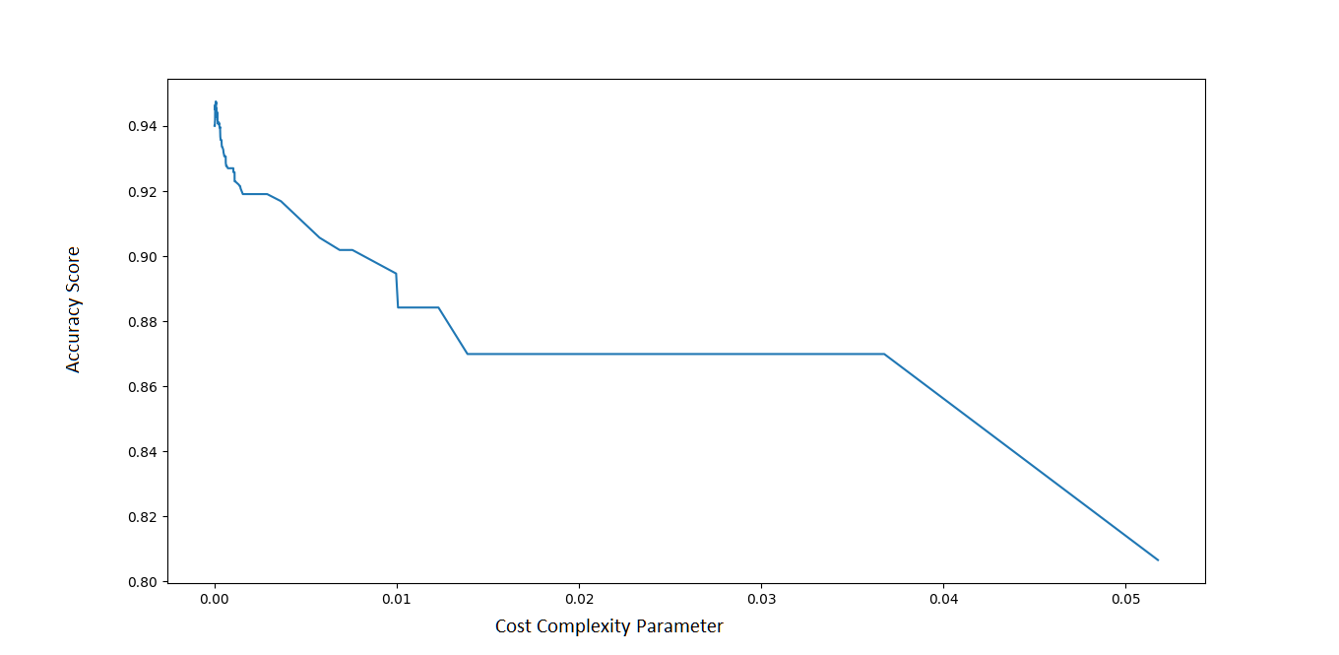
Cost Complexity Parameter

Slide 4
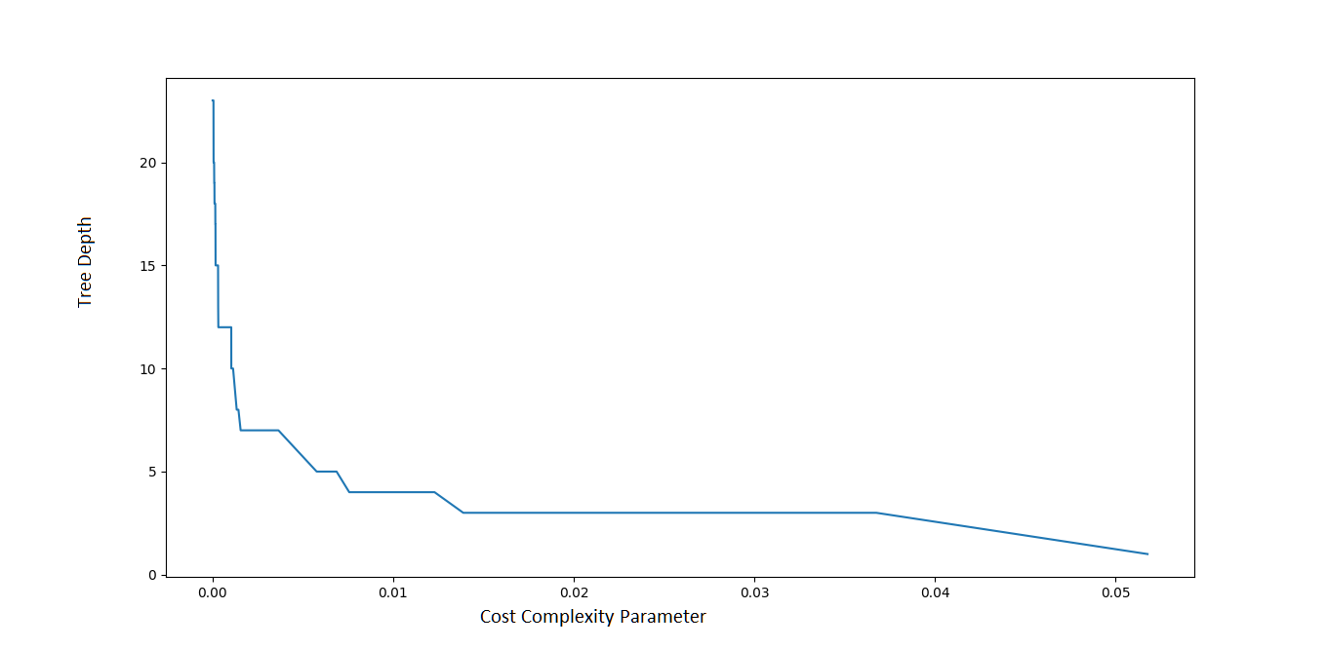
Max Depth

Slide 5
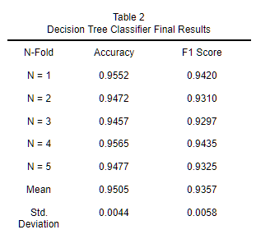
Decision Tree Classifier Results
The results after pruning and correcting the imbalance
The biggest fix was the imbalance correction. This is due to SMOTE + ENN

Slide 6
Multilayer Perceptron Classifier
Most default settings were kept, some were changed.
Solver was set to adam
Activation was set to logistic
1000 iterations

Slide 7
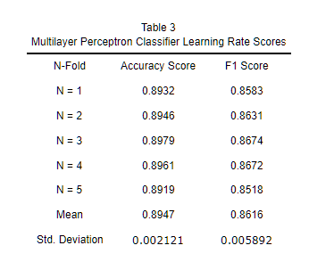
Multilayer Perceptron Classifier Results
It provided consistent results
Trying to correct it was very difficult as most of the default parameters provided really good results.

Slide 8
Lesson’s Learned
The original feature set could’ve been reduced further.
More experiments could have been done on the Perceptron Classifier.
It’s parameter for hidden layer size was very large, and it’s learning rate was very small. This is like the Decision Tree’s cost and depth parameter.

